Slide 1
Attenborough-PEDIA

Slide 2
PROJECT OVERVIEW
Analyse and visualise the subtitles from a David Attenborough documentary series
Learn about Natural language processing and Visualisation
Identify change in language patterns across different series

Slide 3
WHAT HAVE WE DONE
Processed 'Life of Birds' subtitles
NLP to extract nouns, adjectives, and bird names
Constructed network of terms
Performed a range of analysis on the graph/network

Slide 4
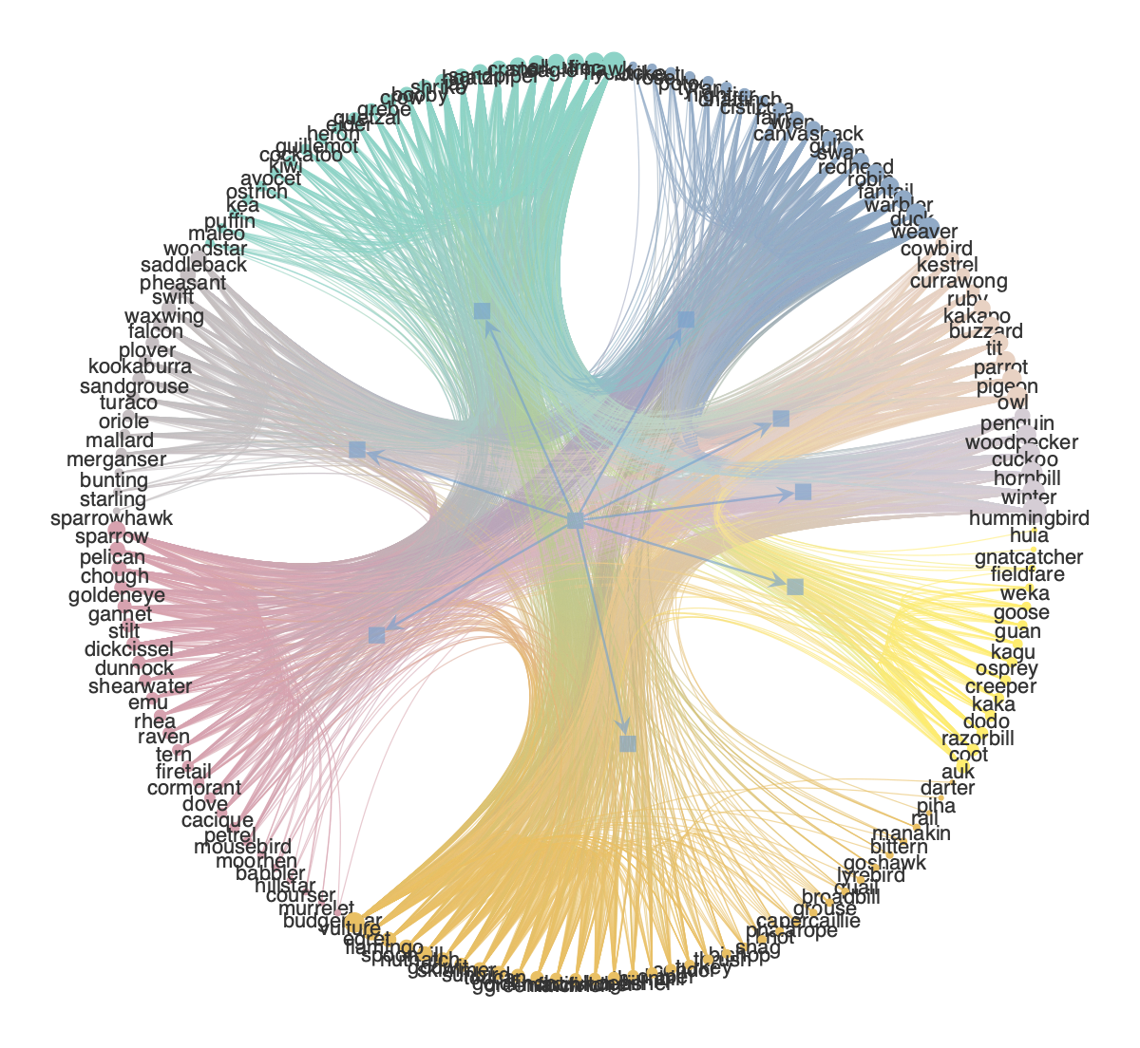
Bipartite Bird Network
Initial Findings

Slide 5
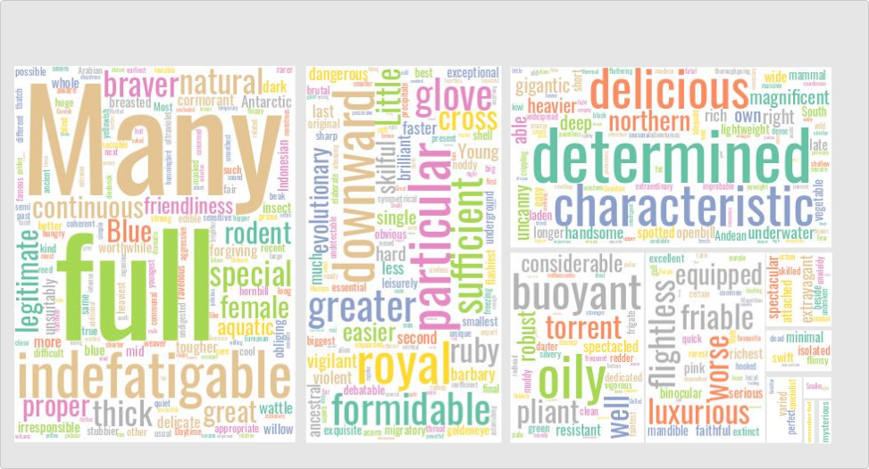
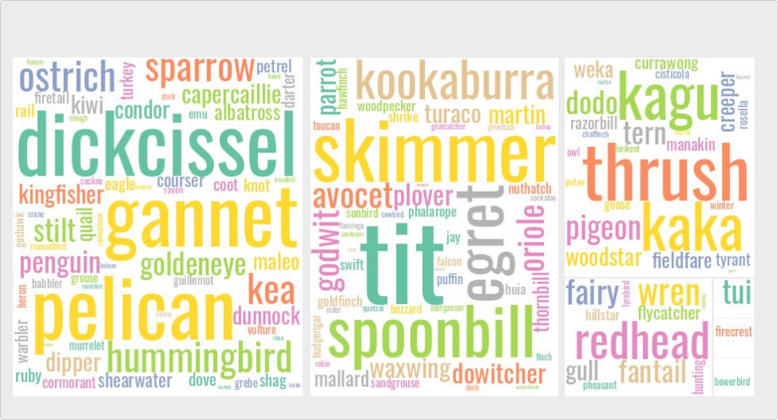
Bipartite Bird Network
Initial Findings

Slide 6
INITIAL FINDINGS
Downloaded and processed 'Life of Birds' subtitles
NLP to extract nouns and adjectives
Identified bird names in subtitles
Loaded nouns and adjectives into network graph tools
Performed a range of analysis on the network

Slide 7
NEXT STEPS
Finalise analysis of Life of Birds
Run processing and analysis over other series
Test for topic/attitude change over time (animals are cool -> save the animals!?!)

